Slide 1
Practical Messaging
A 101 guide to messaging
Ian Cooper
Twitter: ICooper

Slide 2
Who are you?
Software Developer for over 20 years
Worked mainly for ISVs
Reuters, SunGard, Misys, Huddle
Worked for a couple of MIS departments
DTI, Beazley
Microsoft MVP for C#
Interested in OO design
Interested in Agile methodologies and practices
No smart guys
Just the guys in this room

Slide 3
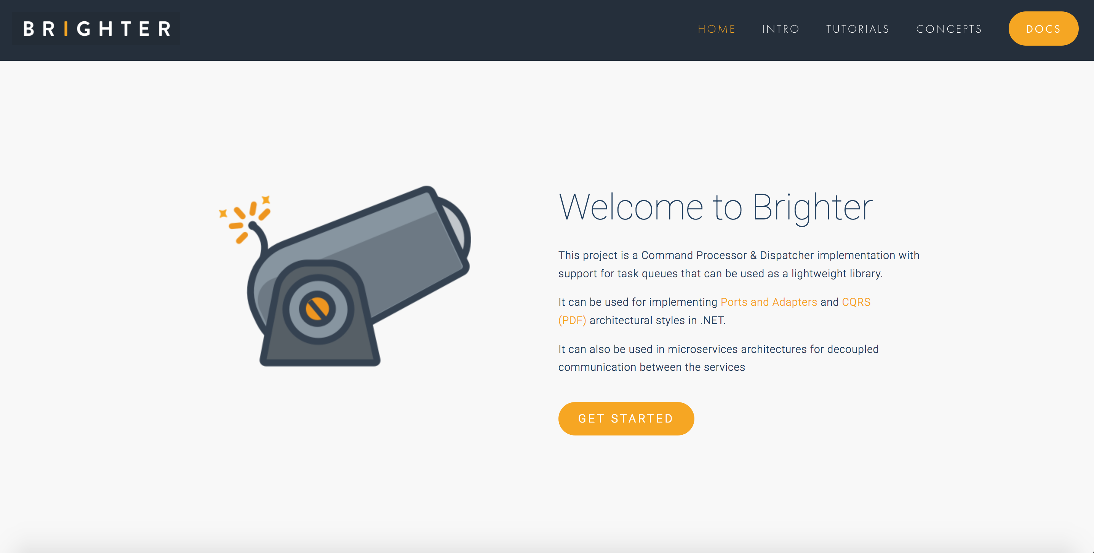

Slide 4
Day One Agenda
Microservices
Integration Styles
Request Driven Architectures
Event Driven Architectures
Messaging Patterns

Slide 5
When do you get to write code?
When we get to messaging patterns, hopefully by the afternoon of Day One and then into the morning of Day Two

Slide 6
Prerequisites
We will use Rabbit MQ for examples. Either you need to have RMQ installed on your machine, or you should have Docker installed on your machine, as exercises provide a Docker Compose file to spin up RMQ.
You will need to be able to author C#, Python, or JavaScript with an editor/IDE of your choice.
You will need Python 3, .NET Core, or ES6

Slide 7
Exercise Code
https://github.com/iancooper/Practical-Messaging-Sharp
https://github.com/iancooper/Practical-Messaging-Python
https://github.com/iancooper/Practical-Messaging-JavaScript

Slide 8
Day One

Slide 9
1.Microservices
What is driving messaging

Slide 10
It’s all about velocity!!!
“Speed wins in the marketplace”
Adrian Cockcroft, former lead architect at Netflix
Notes:
Adrian points out that Continuous Delivery is now “table stakes” for digital companies. You can no longer beat the competition if you have a slow release schedule. We want to ship features as soon as they are done, done! Anything else is inventory waste.
To achieve that, we are going to have to build microservices, once we get beyond a single “two-pizza” team
Although microservices offer a range of benefits, the focus of this deck is how alignment with business capabilities gives us greater productivity, which is the justification for expenditure on the effort required to partition a system into microservices.

Slide 11
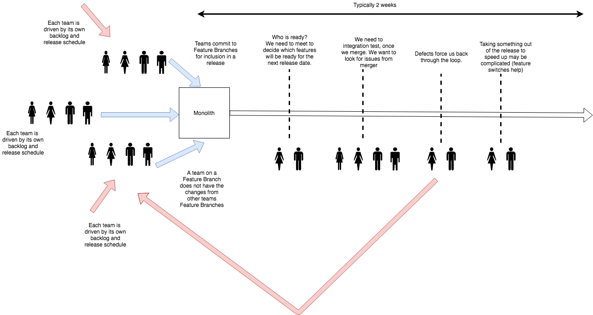
Monoliths Do Not Scale To Many Teams!
Notes:
Monoliths suffer when an organization grows to many teams. Each team has its own backlog, and to avoid contention with other teams changes will branch the repository. When they wish to release, they need to agree with other teams that they will release on a given date, and merge their branch in. Frequently this collides with other teams release schedules, and rather than queue behind each other, they go together. This is because the teams in the rear will have to merge any upstream changes and regression test, before they can release, so to avoid this cost they tend to jump onto the release.
Once all the teams that will join the release are lined up, they merge into the master branch. We then resolve all the conflicts.
More features means more bugs, means greater cost and schedule overruns. If we assume a 30% rework cost, then 30% of 10 days development is 3 days overrun, of 2 days is ½ day.
We must then re-test everything because we have merged potentially incompatible changes.
All the teams now wait on any fixes, even if they belong to another team.
We may be able to drop their changes safely, due to a feature switch, but this can be difficult where they have database changes (a monolith has a shared schema).
Eventually, everyone is ready and we can release, but typically this process takes a couple of weeks. It distracts teams from day-to-day work.
Rollback is also complicated, because we force everyone out. Feature switches and ‘no rollback only roll forward’ become frequent issues.

Slide 12
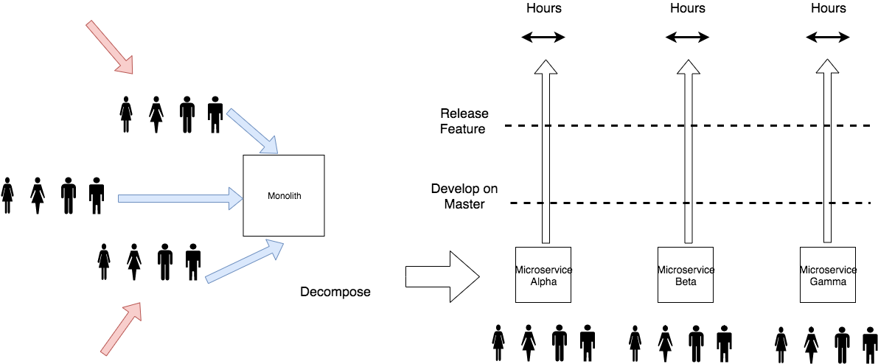
Microservices let us scale an organisation
Notes:
By decomposing software into microservices, oriented around smaller, team-sized units, we can remove these difficulties. Each team only has to negotiate internally to decide on a release candidate.
Typically a team should develop on master behind a feature switch for each story so that they reduce the incidence of any integration costs, and can go straight to production.
Delivery time can be in hours, not weeks.

Slide 13
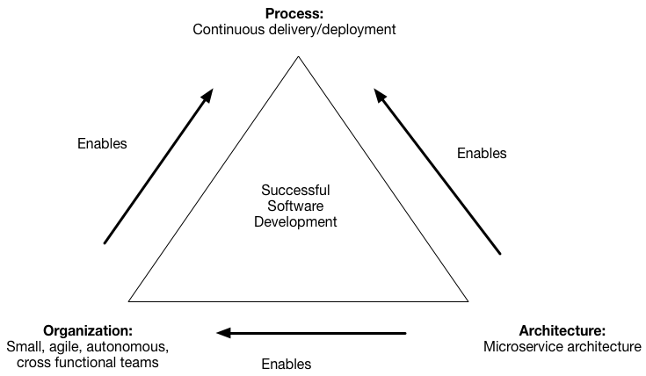
Microservices enable agility
https://microservices.io/patterns/decomposition/decompose-by-business-capability.html
Notes:
This creates a triangle for virtuous software development. Microservices enable small, autonomous teams, who can practice continuous delivery.
Architecture is often an enabler for agile software delivery. You can’t be agile unless your engineering practices support agile delivery. Assuming that we want the benefits of agility (risk reduction through timely feedback, ability to change direction, etc.) we need to use architecture to enable that.
Microservices are a key to unlocking the door of agile at scale, because they let us break up an enterprise a series of small teams, where methodologies like XP and Crystal Clear work. In other words we scale agile, by breaking up the organisation into agile sized units. This doesn’t work if you have a monolith, you will instead be pushed into phased delivery models at scale.

Slide 14
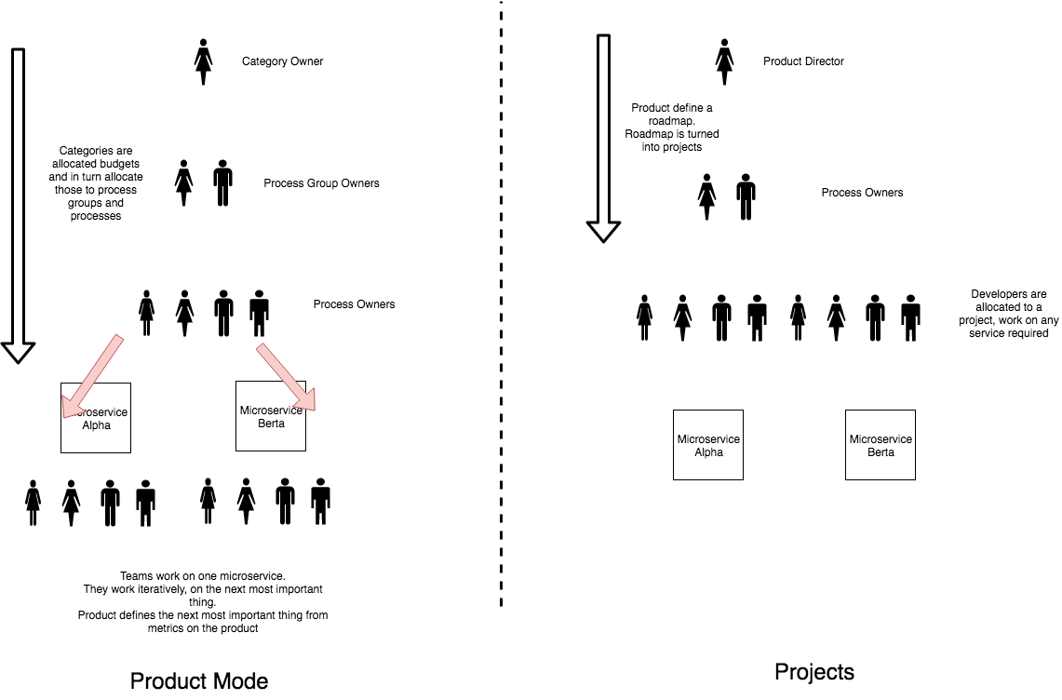
Product Mode
Notes:
In Product mode we allocate resources to products, with a backlog of work for that product, and deliver in an incremental and iterative fashion. There is no end date. Prioritisation is by next highest item. Success is defined by improvement of a metric aligned to a business outcome.
For microservices this means allocating resources to a process, with a backlog of work for that process, which we can deliver on in an incremental and iterative fashion.
In project mode we organise around an item of work that has an end date. Teams work across multiple services to deliver the requirements of the project. Projects are more waterfall than agile as they have significant up-front requirements, and tend to have a long-tail of QA when all the parts must be integrated. Success is defined by ‘keeping to the plan.’ As such projects often conflict with agile methods.
In project mode we have project managers, in product mode we have product owners.

Slide 15
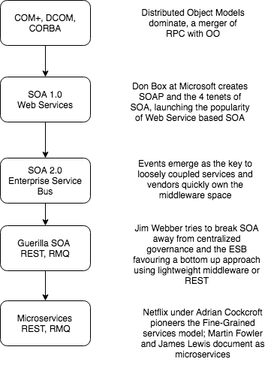
A Brief History of Microservices
The definition of Microservices, we use comes from the paper by Martin Fowler and James Lewis
Notes:
Microservices are really an iteration of SOA, with the vendor control removed, and a focus on loose coupling. Why is this important? Because there is a lot of significant guidance from SOA that is applicable to Microservices, and many operate without knowing that when a microservice document refers to concepts such as ‘business capability’ it means something specific, that has meaning to those who have an SOA background.
So when we talk about microservices there are some things we do not mean, particularly API based services or Entity based services

Slide 16
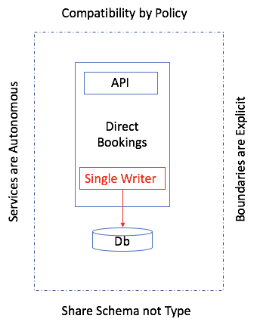
Microservices are partitions of software
Notes:
A microservice is a partition of our monolith that is roughly team-sized in scope and complexity. A microservice needs to be released autonomously, so that we do not have dependencies on other teams for release. This creates the need for the microservice to adhere to the 4 tenets of SOA:
Services are Autonomous: We can be released independently of any other service. This is our goal. It is why we can’t share a Db table for example.
Boundaries are Explicit: We cannot allow other teams to couple to our implementation details, as we want to change these without impacting downstream consumers. So we only interop via a defined contract to an abstraction such as an API or messages, and do not couple to our details. Consumers depend on abstractions, not details
Share Schema not Type: We don’t want to make assumptions about support for a type system in downstream consumers, such as sharing a .NET assembly
Compatibility is by Policy: We adhere to standards such as OpenID to allow us to call our APIs

Slide 17
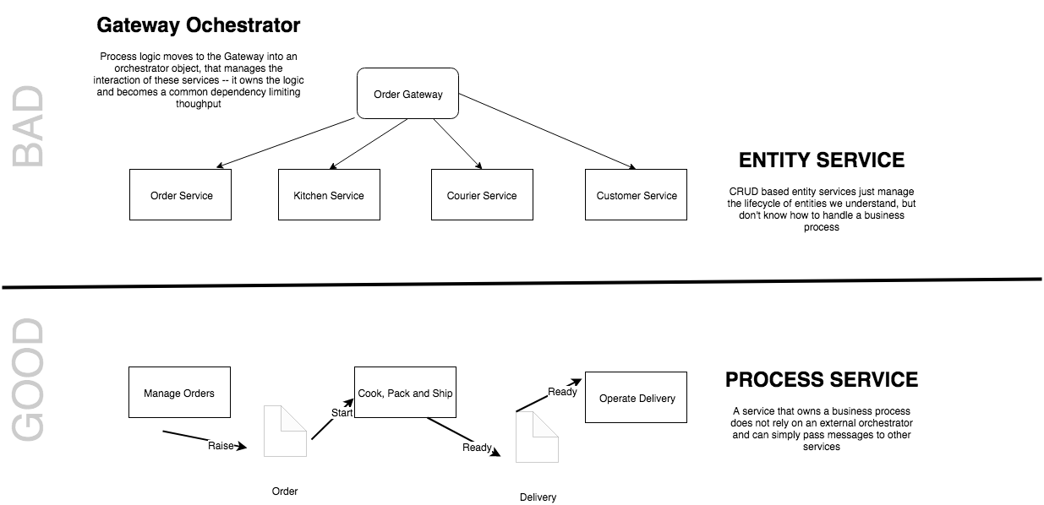
The Entity Service Sniff Test
See Avoiding the Entity Service, Michael Nygard
Notes:
We need to be cautious of modeling microservices by looking for entities in our system and wrapping them with an API. This model tends to result in ‘feature envy’ as the business process logic creeps out of the service and into a Gateway orchestrator. Often this creates temporally coupled services, or the need to copy a lot of data in projections between services. By focusing on a process we can make our services more self-contained and more effectively use messaging to communicate.
Sometimes things just are an entity service, but they tend to be sources of reference data cached locally by other services to do their work

Slide 18
What is a microservice?
SOA is focused on business processes. These processes are performed in different steps (also called activities or tasks) on different systems. The primary goal of a service is to represent a “natural” step of business functionality. That is, according to the domain for which it’s provided, a service should represent a self-contained functionality that corresponds to a real-world business activity.
Josuttis, Nicolai M.. SOA in Practice: The Art of Distributed System Design . O'Reilly Media. Kindle Edition.
Notes:
Whilst this is SOA advice, we are taking the view that microservices are just SOA 3.0, and as such, most of the best practice still applies
The key here is to understand that we want service alignment with a business process or activity. Whilst services offer us benefits such as fault-tolerance through isolation, that is not the thrust of this workstream. Instead this workstream is looking at how microservices improve our productivity, when we get alignment between a service and a business process.
We amplify this point in the next slide, which talks about the entity service anti-pattern

Slide 19
2.Integration styles
How do we communicate between microservices?

Slide 20
Distributed Systems
Performance and Scalability
Availability
Maintainability
Inherent Distribution
Notes:
Distributed Systems 5m
Once upon a time computer systems were stand-alone, they ran on one-machine. But modern design tends to be distributed with parts running on different computing nodes. Why?
Performance and scalability: As systems become successful it becomes necessary to scale them to meet demand with adequate performance. With a distributed system we can scale-out by introducing new nodes and spread load, and we can also scale up parts of our offering to improve performance by making more expensive hardware available.
Availability: The problem of 'one' plagues computing. If I have 'one' computing node then failure stops my system running. But if we have redundant computing nodes we can rely on those nodes to provide service - perhaps degraded, until we can replace the node. This makes systems fault tolerant.
Maintainability: It becomes hard to maintain large monolithic systems: if you have to test the whole system in order to release it testing becomes an obstacle to release, often slowing release schedules and creating inventory waste; developers find it hard to grasp the 'whole', it's too big to reason about effectively. This often creates a 'banyan tree' anti-pattern with multiple solutions to the same problem, duplication, and if coupling is bad a 'big ball of mud'. Splitting a system into parts creates components that can be developed, QA'd and released independently reducing the problem of complexity to a more manageable size, improving our ability to reason about software, shortening the time to QA software and reducing inventory waste.
Inherent distribution: Some applications are inherently distributed such as business systems that span company divisions in multiple regions of the world, peer-to-peer content sharing etc.

Slide 21
Integration vs. Distribution
An n-tier system is distributed, but not integrated
A distributed system tends to use synchronous communication because the parts are not independent
An integrated system can often use asynchronous communication because the applications are independent
Notes:
Integration vs. Distribution
An n-tier system is distributed, but not integrated
A distributed system tends to use synchronous communication because the parts are not independent when delivering functionality to the user and are thus sensitive to response times
An integrated system can often use asynchronous communication because the applications are independent of each other and each can function without the other — allowing one to hand off to another without the expectation of timing of the result
[Worth noting that in the Fred George school of micro services, many of the services are ’tiers’ of a distributed application, broken out, hence gRPC whereas in Fowler/Lewis SOA school the parts are independent and so can tend to interoperate asynchronously]

Slide 22
Fallacies of Distributed Computing
The network is reliable.
Latency is zero.
Bandwidth is infinite.
The network is secure.
Topology doesn't change.
There is one administrator.
Transport cost is zero.
The network is homogeneous.
Notes:
Networks are Unreliable
The effects of the fallacies
Software applications are written with little error-handling on networking errors. During a network outage, such applications may stall or infinitely wait for an answer packet, permanently consuming memory or other resources. When the failed network becomes available, those applications may also fail to retry any stalled operations or require a (manual) restart.
Ignorance of network latency, and of the packet loss it can cause, induces application- and transport-layer developers to allow unbounded traffic, greatly increasing dropped packets and wasting bandwidth.
Ignorance of bandwidth limits on the part of traffic senders can result in bottlenecks over frequency-multiplexed media.
Complacency regarding network security results in being blindsided by malicious users and programs that continually adapt to security measures.^{[2]}
Changes in network topology can have effects on both bandwidth and latency issues, and therefore similar problems.
Multiple administrators, as with subnets for rival companies, may institute conflicting policies of which senders of network traffic must be aware in order to complete their desired paths.
The "hidden" costs of building and maintaining a network or subnet are non-negligible and must consequently be noted in budgets to avoid vast shortfalls.
If a system assumes a homogeneous network, then it can lead to the same problems that result from the first three fallacies.
History
The list of fallacies generally came about at Sun Microsystems. L. Peter Deutsch, one of the original Sun "Fellows", is credited^{[by whom?]} with penning the first seven fallacies in 1994; however, Bill Joy and Tom Lyon had already identified the first four as "The Fallacies of Networked Computing"^{[3]} (the article claims "Dave Lyon", but this is a mistake^{[why?]}). Around 1997, James Gosling, another Sun Fellow and the inventor of Java, added the eighth fallacy.^{[3]}

Slide 23
File Transfer
Two processes communicate via the Producer writing to a file, and the Consumer reading from it.
A common data transfer mechanism that can be used by a variety of languages and platforms and feels neutral towards each
Requires agreement: file names, locations, who manages files
Will create eventual consistency between systems due to periodic nature of publication
Notes:
File Transfer
A common data transfer mechanism that can be used by a variety of languages and platforms and feels neutral towards each
All OSs and languages tend to support reading files
We need to agree format
Produced at an interval (Weekly, Nightly, Hourly…)
No need to understand internals of applications
Requires agreement: file names, locations, who manages files
Needs locking
Will create eventual consistency between systems due to periodic nature of publication
At higher frequency of production, management of files means we tend to switch to messaging
Integrates data but not functionality.

Slide 24
Shared Database
Two processes communicate by the Producer writing to a database and the consumer reading from it.
Creating a unified schema that can meet the needs of all applications is a challenge
Breaks encapsulation and causes change to ripple across all applications
Often the Db supporting many enterprise-wide applications becomes the bottleneck
Notes:
Shared Database
Removes timing, format and locking issues inherent in File Transfer
Creating a unified schema that can meet the needs of all applications is a challenge
Delays in cross-team projects caused by unified schema issues tend to push fragmentation
Often the Db supporting many enterprise-wide applications becomes the bottlneck with so many systems writing to it
You are, in effect, multi-tenant with other applications and can suffer from the ‘noisy neighbour’ issue
Breaks encapsulation and causes change to ripple across all applications
May cause ‘resistance to change’ and failure to meet the needs of the business
Integrates data but not functionality.

Slide 25
Remote Procedure Call
Two processes communicate by the client causing a procedure to execute in another address space belonging to the server, coded as if it were a local call.
Integrates functionality not data
Behavioral coupling can tie the systems together in a knot, particularly due to sequencing
Notes:
Remote Procedure Invocation
Integrates functionality not data
RPC preserves encapsulation — you call my shared business function - and allows each application to preserve integrity of its internals
Each application can now change independently
Allows LMI syntax for RMI
This is a disadvantage [Waldo]
Behavioural coupling can tie the systems together in a knot, particularly due to sequencing
is an issue of not understanding that as RMI is not LMI design needs to be different to be effective

Slide 26
Messaging
Two processes communicate by the Producer sending a packet of data to a channel and the Sender reading that packet of data from the channel.
Asynchronous communication does not require both systems to be up and ready at the same time.
Messages can be transformed in transit without sender or receiver knowing
Small messages frequently allows behavioral as well as data collaboration
Notes:
Messaging
Loosely coupled integration.
Asynchronous communication is a fundamentally pragmatic reaction to the problems of distributed systems. Sending a message does not require both systems to be up and ready at the same time. Furthermore, thinking about the communication in an asynchronous manner forces developers to recognise that working with a remote application is slower, which encourages design of components with high cohesion (lots of work locally) and low adhesion (selective work remotely).
Allow decoupling: messages can be transformed in transit without sender or receiver knowing
This allows sender and receiver to have different conceptual models
Small messages frequently allows behavioral as well as data collaboration
Even so eventual consistency remains an issue

Slide 27
Decoupled invocation
An example of messaging based integration

Slide 28
Decoupled Invocation
An application may experience peaks of demand that cause it to become overloaded and unable to respond.
It could be that part of the application itself becomes overwhelmed or one of its dependencies becomes overwhelmed.
Notes:
Context and Problem
An application may experience peaks of demand that cause it to become overloaded and unable to respond.
It could be that part of the application itself becomes overwhelmed – due to a lack of CPU or memory – or it could be that the application depends on a third-party service that can become overwhelmed.
For example, there is a limited number of connections in a database connection pool. Long-running queries can lead to a lack of available connections to service requests. These requests in turn back up and overwhelm a server’s thread pool. This can cause queueing of requests on the server. Eventually the server stops serving requests.
“Done well, middleware simultaneously integrates and decouples systems. It integrates them by passing data and events back and forth between the systems. It decouples them by letting the participating systems removing specific knowledge of and calls to the other systems. Since integration points are the number-one cause of instability, this looks like a good thing.”
“Any kind of synchronous call-and-response or request/reply method forces the calling system to stop what it’s doing and wait. In this model, the calling system and the receiving system must both be active at the same time—they are synchronous in time—though they may be in different places. This category covers remote procedure calls (RPC), HTTP, XML-RPC, RMI, CORBA,
DCOM, and any other analog of local method calls. Tightly coupled middleware amplifies shocks to the system. Synchronous calls are particularly vicious amplifiers that facilitate cascading failures.”

Slide 29
DIAGRAM: Have a service A that calls B that calls a Db. Next picture service Db faults due to connection pool limit. B faults due to queueing waiting for the Db. A faults waiting for B. Now show a queue between A and B. Show that B can throttle the rate it reads from the queue to stay within limit of the Db connection pool.

Slide 30
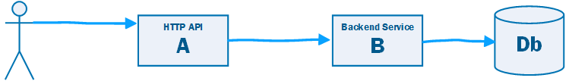

Slide 31
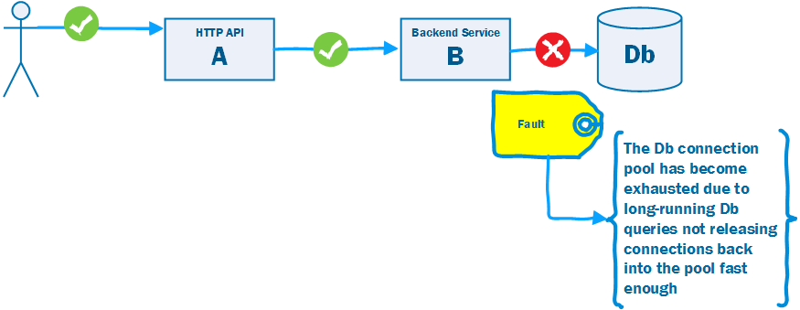

Slide 32
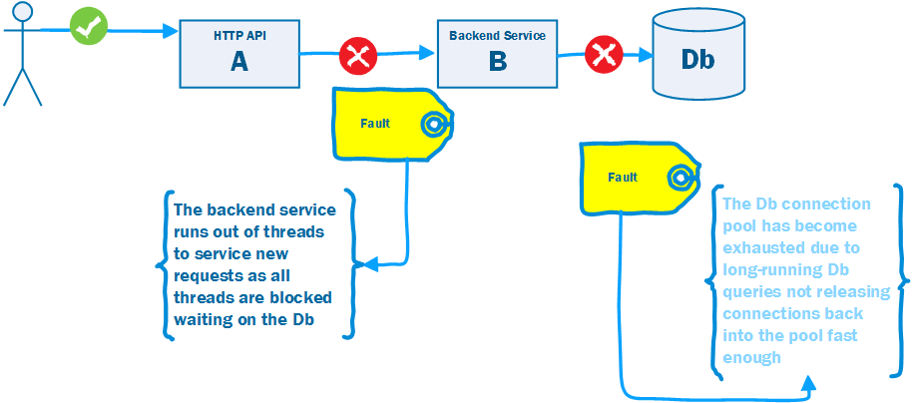

Slide 33
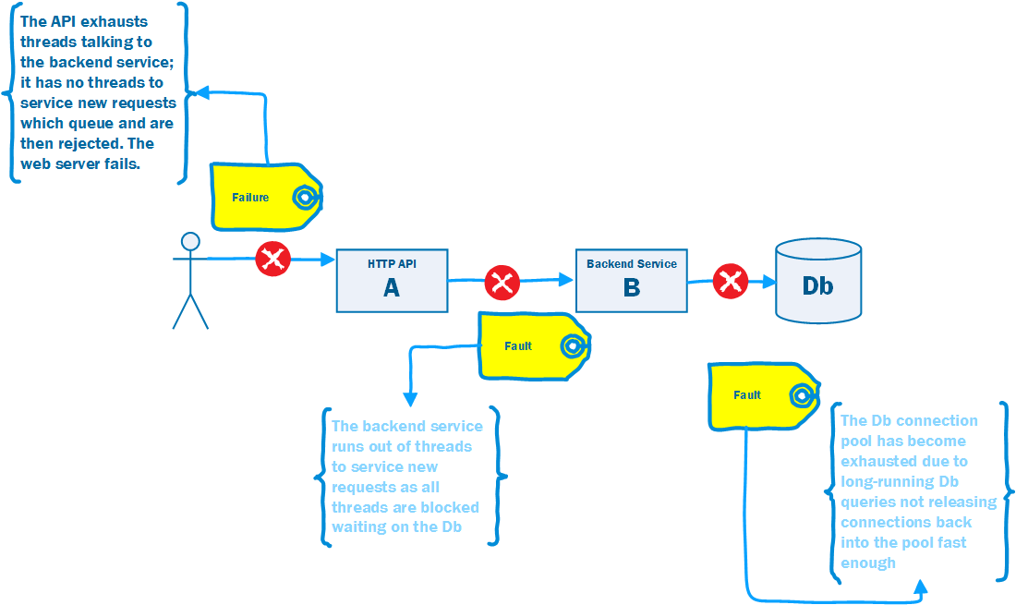

Slide 34
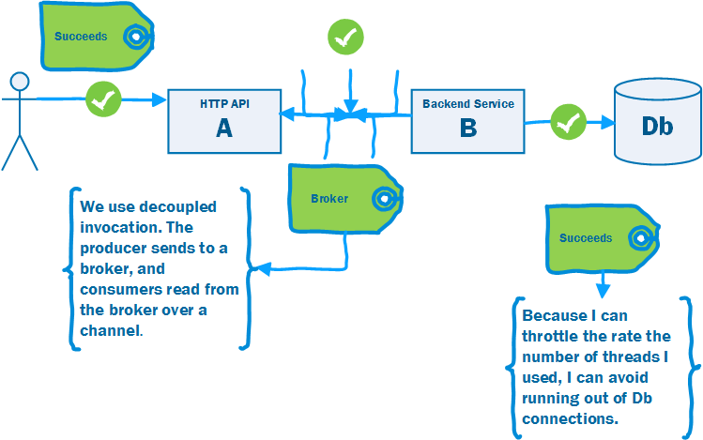

Slide 35
Decoupled Invocation Pattern
Use Decoupled Invocation. A producer puts a message onto a queue at the service endpoint. A consumer reads messages from the queue.
The queue stores messages for eventual processing. If the queue is durable we gain guaranteed delivery, and at-least once guarantees.
If the rate of arrival at the endpoint is unpredictable, the queue acts as a buffer that makes it possible to predict the rate of consumption.
This makes it simpler to do capacity planning because peaks of requests are smoothed out by the queue.
The consumer must be able to control the rate of processing, otherwise a spike is simply passed down the wire.
Notes:
As illustrated in figure 3.3, the Decoupled Invocation pattern is composed of three basic components: a handler, a queue, and a dispatcher that mediates between them. Here’s how the initial request processing works:
The handler listens for incoming requests from the endpoint.
When a new request arrives, the handler sends an acknowledgment to the sender.
The handler is responsible for the initial treatment, or preprocessing, of incoming messages. This may include message transformation or prioritization based on knowledge it infers from the messages themselves. Overall, this processing should be kept minimal, as the goal is to quickly queue and acknowledge incoming requests.
The message is put onto a queue.
The queue, which is the second component of the Decoupled Invocation pattern, stores incoming messages and allows the service to consume the messages at its own steady rate, thus overcoming peak loads.
You can set up the queue to be persistent so the service won’t lose any requests it has already acknowledged, even if a catastrophic server failure occurs. If the queue is transactional, you can also implement the Transactional Service pattern (see chapter 2) and increase the overall robustness of the service even further.
The dispatcher is responsible for creating as many reader components as are needed for the current request load, which is measured by the number of messages waiting in the queue. The dispatcher can also prioritize incoming tasks based on internal considerations, such as resource availability. The dispatcher is a good place to introduce elasticity if the latency of handling the messages is important. (See also the further reading section for an article on the LMAX architecture, which describes a low-latency, high-performance queue between senders and receivers.)
The handler can acknowledge the request as part of the preprocessing, but it’s usually best to do this inside an edge component (see the Edge Component pattern in chapter 2). This helps ensure that the service-processing load is kept to a minimum, allowing the handler to process requests as efficiently as possible.
Placing requests on the queue is a relatively low-cost operation that can be performed efficiently, making the initial request-handling less susceptible to failure during peaks (as compared to other parts of the request-handling that require more time and resources). The actual handling of the incoming requests can be performed at a reasonable pace, dictated by service resource availability and overall load. Load balancing can be achieved by running multiple readers against the queue.

Slide 36
Work Queue Pattern
A common distributed system (as opposed to integrated system) pattern.
A web site needs to respond < 250ms to scale. But some requests take longer…
Use decoupled invocation to put the work on a queue, offloading the long-running tasks, allowing the web server to respond in time.
202 Accepted and provide location to monitor for completion.

Slide 37
3.Request driven architectures
Integrating using RPC or REST

Slide 38
Request Driven Architecture
Direct
Bookings
Credit Card
Payments
Accounts
Housekeeping
Channel Manager
API
API
API
API
API
Db
Db
Db
Db
Db
Broker
Notes:
Temporal coupling is the problem that in order for us to make a Direct Booking the Channel Manager needs to be working. If we cannot update the channels, we do not take the customer’s booking. But of course this is problematic (1) Our uptime for our Direct Bookings Service is the product of the uptime of all the services that it calls (2) The channel manager may depend on external channels that have low uptimes and if so our direct bookings service becomes only as available as the worst availability of our channels (in fact worse as it is the product).
And would the business prefer: we can take a booking but might risk over-booking because one of our channels offers a room that we have already sold, or that we don’t take any bookings because we cannot guarantee against over-booking. For most business it is arguably the former
The server must be available when you call.
if I make a phone call, and you are not there I am shit out of luck. RPC is a phone call, direct communication between two participants and can be frustrating if you get a busy tone or no one answers. (nowadays we may leave an answer phone message, or send a text, but this is messaging not RPC). We will come to that later.
Pooling of resources can help here – one of anything can fail, so you need multiple servers
To avoid the client now having to know about where a server lives, which again defeats concept of RPC, then you have to use service-discovery in your runtime, so that location is hidden to caller. Good idea anyway, even if location transparency not our goal, not to have a fixed location.
Not true of decoupled invocation i.e. messaging of course.
“... the degree to which the sending and handling of a message are connected in time. If a sender is dependent on a receiver being available when a message is sent, we have high temporal coupling... Processes whose activities are strictly ordered or whose results carry forward, leaving subsequent activities unable to start until a response to a prior request has been received, are similarly temporally coupled. “ Ian Robinson

Slide 39
Request Driven Architecture
Direct
Bookings
Credit Card
Payments
Accounts
Housekeeping
Channel Manager
API
API
API
API
API
Db
Db
Db
Db
Db
Broker
Notes:
Temporal coupling is the problem that in order for us to make a Direct Booking the Channel Manager needs to be working. If we cannot update the channels, we do not take the customer’s booking. But of course this is problematic (1) Our uptime for our Direct Bookings Service is the product of the uptime of all the services that it calls (2) The channel manager may depend on external channels that have low uptimes and if so our direct bookings service becomes only as available as the worst availability of our channels (in fact worse as it is the product).
And would the business prefer: we can take a booking but might risk over-booking because one of our channels offers a room that we have already sold, or that we don’t take any bookings because we cannot guarantee against over-booking. For most business it is arguably the former
The server must be available when you call.
if I make a phone call, and you are not there I am shit out of luck. RPC is a phone call, direct communication between two participants and can be frustrating if you get a busy tone or no one answers. (nowadays we may leave an answer phone message, or send a text, but this is messaging not RPC). We will come to that later.
Pooling of resources can help here – one of anything can fail, so you need multiple servers
To avoid the client now having to know about where a server lives, which again defeats concept of RPC, then you have to use service-discovery in your runtime, so that location is hidden to caller. Good idea anyway, even if location transparency not our goal, not to have a fixed location.
Not true of decoupled invocation i.e. messaging of course.
“... the degree to which the sending and handling of a message are connected in time. If a sender is dependent on a receiver being available when a message is sent, we have high temporal coupling... Processes whose activities are strictly ordered or whose results carry forward, leaving subsequent activities unable to start until a response to a prior request has been received, are similarly temporally coupled. “ Ian Robinson

Slide 40
Using A Proxy for Availability
We load balance the requests across multiple servers
Health Checks let us know who can we route to
Proxy
Proxy
Proxy
Proxy
Credit Card
Payments
Accounts
Housekeeping
Channel Manager
Direct
Bookings
Credit Card
Payments
Housekeeping
Channel Manager
Credit Card
Payments
Housekeeping
API
API
API
API
API
Channel Manager
The proxy can also support retry and or circuit breakers to help with availability
Db
Db
Db
Db
Db
Notes:
By using a proxy we can load balance our request across a group of servers – thus reducing our dependency on any one service being up and thus improving our availability\
If the service exports a health check then we can ensure that we only route to servers that are up, and thus able to fulfill our requests
We can also make retry and circuit breaker orthogonal concerns here, eliminating transient errors and preventing a thundering herd when it does happen

Slide 41
Config
Discovery
Monitoring
Policy
Control Plane
Data Plane
Proxy
Proxy
Proxy
Proxy
Proxy
Direct
Bookings
Credit Card
Payments
Accounts
Housekeeping
Channel Manager
Direct
Bookings
API
API
API
API
API
Credit Card
Payments
Housekeeping
Channel Manager
Direct
Bookings
Credit Card
Payments
Housekeeping
Channel Manager
Db
Db
Db
Db
Db
Notes:
If everything goes via a proxy, that proxy can be used as an interception point for centralizing services:
Configuration – we can dynamically provide configuration based on the runtime environment
Discovery – we can register new instances of services, allowing us to load balance across service instances
Monitoring – we can trace requests and provide visibility as to service health
Policy – authentication, TLS, rate limiting etc

Slide 42
Change Happens
?
Cleaning
API
Direct
Bookings
Credit Card
Payments
Accounts
Channel Manager
API
API
API
API
Db
Laundry
API
Db
Db
Db
Inventory
Db
Db
API
Broker
Db
Notes:
If we decide that we need to make changes to our capability map – for example we begin to break down the Housekeeping service – realizing that it was a group that supported a number of capabilities

Slide 43
Location Independence
Platform Coupling
Connection-Oriented
Synchronous Communication
Domain Coupling
Data Format
Notes:
However RPC has its own issues because it does not resolve:
Location Independence: We would like clients to not have to know the location of a component which becomes particularly important if we want to redirect the client for performance or fault-tolerance
Platform Coupling: RPC tends to depend on both sender and receiver using the same platform, which may not always be possible, and means that we tie future change into what may be a 'legacy' technology
Connection Oriented RPC often requires us to make a series of calls to an interface to meet a requirement, and some calls must be made before others such as initializing the receiver. What is worse is that remote objects may depend on other objects and there is no mechanism for managing these dependencies, which means that developers must orchestrate these dependencies instead. This couples the client and receiver into a sequence of operations that must occur in sequence, which makes the software brittle to change.
connection-oriented protocol creates a session and then sends a stream of data between two applications in order. It is not fault tolerant as it assumes that the sender and receiver are both available at the same time. Defensive code becomes complicated bearing in mind that one of the components might not be available at the required time.
Synchronous Communication: RPC tends to depend on synchronous communication in which requests flow from clients and responses flow from the server. The problem here is that the client must create a session with the server to communicate, which does not easily allow fault-tolerance or publishing to multiple consumers at the same time. It also performs badly because the blocking call from the client ties up compute resources on the client whilst waiting on a response from the server.
Domain Coupling: One of our four tenets is to share schema not type - the problem with RPC is that it tends to share type, which bleeds the model of one domain into another. Now we can limit the damage here to some extent by using ideas like an anti-corruption layer to translate between models, but we are coupled to the types in the other system and will need to change if they change, if only to change out anti-corruption layer.
Data Format: The client and server are bound by the ordering, type and number of parameters. If the server changes then the client will break. This forces us to to confirm client behavior by testing when we change the sender
Trying to portray a remote communication as local-method invocation leads to trouble, because it elides from the developer the issues associated with a remote call.

Slide 44
4.Event driven architectures
Integrating using events

Slide 45

Event Driven Architecture
“Messaging over a lightweight message bus such as RabbitMQ”
Fowler and Lewis
Direct
Bookings
Credit Card
Payments
Accounts
Housekeeping
Channel Manager
API
API
API
API
API
Consumer has no notion of producer, just a topic on tbe broker
Channels subscribes to a ‘topic’ on the broker
Db
Db
Db
Db
Db
Broker
Notes:
A service publishes an event to a broker – usually using a topic or similar identifier
A consumer subscribes to that topic on the broker and receives messages
The channel usually offers guaranteed at least once delivery avoiding the issue of temporal coupling

Slide 46
Event Driven Architecture
Channel provides guaranteed at least once delivery
Direct
Bookings
Credit Card
Payments
Accounts
Housekeeping
Channel Manager
API
API
API
API
API
Db
Db
Db
Db
Db
Broker
Notes:
A service publishes an event to a broker – usually using a topic or similar identifier
A consumer subscribes to that topic on the broker and receives messages
The channel usually offers guaranteed at least once delivery avoiding the issue of temporal coupling

Slide 47
Event Driven Architecture
Direct
Bookings
Credit Card
Payments
The producer, Bookings, does not care that I split Housekeeping
Channel Manager
API
API
API
Cleaning
Laundry
API
API
Db
Db
Db
Db
Db
Broker

Slide 48
Platform independent data format
Sent to an addressable channel
Supports data transformations
Remote Communication
Platform/Language Independence
Asynchronous Communication
Throttling
Reliable Communication
Notes:
Standard data format that is platform independent: XML, JSON, YAML, CSV etc.
Send to an addressable channel and not to a specific machine (i.e. IP Address or domain name)
- A channel is a logical address which sender and receiver can agree on without knowing each other's true location
- As channel may be built on connection-oriented protocol, queue requests until the network and receiver are ready
- We need to support chunks of data or messages so that we know what to queue, instead of using a stream of data
Support data transformations so as to remove the dependency on a shared data format.
Remote Communication: Solves the problem of two applications communicating when they do not share a memory address space
Platform/Language Integration: Does not require the producer and consumer to use the same platform or language
Asynchronous Communication: Sender does not have to wait for receiver.
Throttling: We are able to queue requests for resources that are under contention so allowing us to throttle input to avoid overloading resources, instead allowing the receiver to consume that at a sustainable pace. At the same time we do not need to throttle the sender who can work at their preferred pace.
Reliable Communication: Message queues support retrying delivery of messages which means that once we send a message we know it will reach its destination. We can use guaranteed delivery to store these messages to persistent storage so that even if we lose the node trying to deliver the message we will be able to resume with no loss of messages.
More immediate than File Transfer; better encapsulated than shared database; more reliable than RPC
Does not require platform or language inter-operability between sender and receiver - an neutral broker
Asynchronous Communication [Fire-and-Forget]
Variable Timing [Sender does not wait for Producer]
Throttling [Receiver processes at own rate]
Reliable Communication [Store and Forward beats Temporal Coupling, Guaranteed Delivery]
Disconnected Operations [For example, work offline]
Mediator [Messaging provides service discovery, because only need to connect to the broker which routes messages to receivers; broker can be clustered to cope with failure]
Thread Management [The sender does not block waiting for the caller; the receiver does not block waiting for the sender

Slide 49
Messaging depends on Message-Oriented-Middleware (MOM)
Messaging depends on Message-Oriented-Middleware (MOM)
Routes messages between applications
Co-ordinates sending and receiving of messages
Sender and receiver have the same availability
Asynchronous: Send and Forget
Store and Forward
Notes:
Messaging depends on Message-Oriented-Middleware (MOM)
Routes messages between applications
Co-ordinates sending and receiving of messages
A messaging system overcomes issue with reliability - temporal coupling - as the sender and receiver have the same availability
Create
Send
Deliver
Receive
Process
Send and Forget
A sender does not block once the message reaches the MOM
Store and Forward
When the sending application sends, the MOM stores the message
Delivery can be retried until it succeeds
This is ‘guaranteed delivery’ and it overcomes temporal coupling

Slide 50
Complex Programming Model
Sequencing
Eventual Consistency
Many Moving Parts
Performance
Lock-In
Notes:
Disadvantages of Messaging
Complex programming model: Application logic in an event-driven system is divided across a number of event handlers that respond to incoming messages. This can make it harder to reason about the system and its effects. Debugging becomes harder because we may have to open up multiple IDEs, or read a variety of different logs. We may also have more complex concerns around how to monitor systems, heavier configuration requirements, and generally an increased burden to support our system in a live environment.
Sequencing: Message channels do not usually guarantee order and timing, so messages may be received out of sequence, and care is needed to handle this issue.
Consistency: Essentially messaging systems have high availability and partition tolerance, but lose consistency. This is due to the latency in sending, receiving and processing a message between two systems which means they may provide inconsistent views of state at any one time.
Availability: Messaging systems have more moving parts as well as the MOM itself. This is a more complex availability problem because unlike a monolithic system where we only have to introduce redundancy and load balancing for one component we now have to introduce redundancy and load balancing for many components.
Complex Programming Model [Asynchronous and Event-Driven]
Sequencing [May be hard to control timing of processing of messages]
Synchronous Requirements [Some applications require synchronous responses]
Performance [Time to package, send, unpackaged; throttling slows rate causing eventual consistency or even partition]
For bulk data transfer - ETL followed by updates over messaging faster than just messaging
Limited Platform Support [Not all MOM available everywhere (MQMQ on Linux?)]
Vendor Lock-In [A vendor product lies at the heart of the application]

Slide 51
Contrasting requests and events
Integrating using events

Slide 52
RPC: How to Make a Good Cup of Tea
“Now this is serious! if there’s one thing in this country that really bothers me/ Its’ the inability of yanks to make a good cup of tea”
T.U.S.A. Masters of Reality.

Slide 53
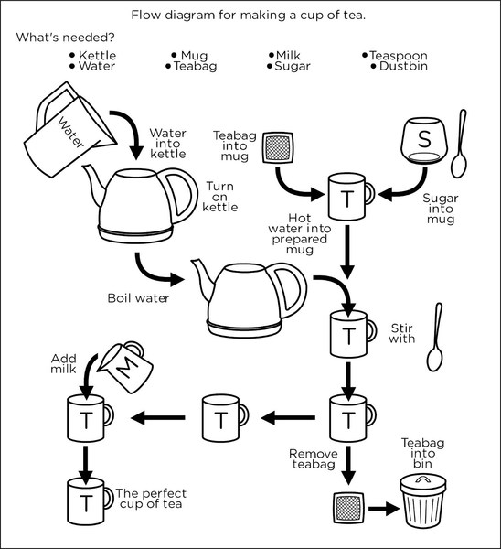

Slide 54
Demo
Notes:
~PythonProjects/github/iancooper/RpcIsEvil/
Make sure that you run virtualenvwrapper to load the python environment first!

Slide 55
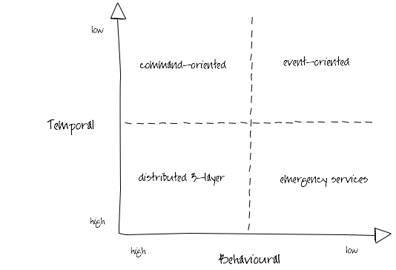
Ian Robinson: http://iansrobinson.com/2009/04/27/temporal-and-behavioural-coupling/
Notes:
Distributed 3-layer
Traditional 3-layer application architecture blown up to distributed proportions. Characterized by call stack-like, imperative behaviour (high temporal and behavioural coupling) and synchronous request-response interactions. Includes systems that layer synchronous interactions on top of asynchronous message exchanges. Senders tell receivers what to do; receivers execute the sender’s orders. Sender and all intermediaries block until the call stack unwinds, effectively locking and/or consuming system resources further up the call chain. This blocking behaviour undermines the autonomy of upstream components and at the same time increases the availability requirements of downstream components. As Michael Nygard’s Release It! reminds us, in these circumstances the availability of the overall system can be no more than that of the least available participant, and the probability of failure is the joint probability of failure in any component or service.
Command-oriented
“Good”, “orthodox” SOA. Low degree of temporal coupling characterized by asynchronous interactions, deferred state and a resumable programming model (process or activity instances are dehydrated between remote invocations in order to conserve resources, and then rehydrated based on correlated responses). Senders typically determine what needs to be done, but rely on receivers to determine how to execute their instructions. This behavioral coupling can require providers to evolve (message formats, supported operations) in lockstep with changing consumer demands.
Event-oriented
Low temporal and behavioral coupling. Receivers determine both what needs to be done and how to do it based on the content of received messages. Resumable programming model: processes are suspended or dehydrated, waiting for events. Can be difficult to trace the execution path of an end-to-end transaction or activity. Exposing an ExtinguishFire operation is a command-oriented way of executing a business process; acting on FireStarted notifications an event-oriented approach.
Emergency services
So called because you tell them what happened, and they decide what to do, but if there’s no one to take your call, you’re hosed. Low behavioural coupling, which allows for the independent evolution of system components, but a degree of temporal coupling, impacting availability requirements of participants. Many RESTful solutions occupy this quadrant. URI-templated solutions have a higher degree of behavioural coupling than hypermedia-driven solutions (where servers constrain and guide what a client can do next, and determine how best to satisfy requests); client polling and caching can mitigate some of these temporal coupling issues.

Slide 56
5.Messaging patterns
Integrating using events

Slide 57
5.1 types of messages

Slide 58
Message Construction
A message has a header and body
Message Intent: Command, Document, Event
Request-Reply: needs Return Channel and Correlation Identifier
Break a large message into pieces as a Message Sequence
Slow messages: One way to deal with eventual consistency is to create a Message Expiry
Notes:
Messages 5m
- Two processes communicating need to copy the data between processes - usually as a stream of bytes. We need to break up this stream into discrete units so that we can tell when a message on the channel begins and ends. Otherwise we could not use competing consumers to read messages from the stream or publish to multiple subscribers
- A message has a header, how to process and a body, the content
- Three types: Command (invoke), Document (share data), Event (notify of change)
- The difference between event and document are that with document the emphasis on the content of the message, with an event the emphasis is on the occurrence itself.
Message Intent: Command, Document, Event
Request-Reply: (Usually Command-Document), tends to use Return Address and Correlation Identifier
In essence RPC over messaging
Break a large message into pieces with Message Sequence
Slow messages: One way to deal with eventual consistency is to create a Message Expiry, and if a message is not delivered within a time-window delete or add to Dead Letter Queue
Message: An atomic packet of data transmitted on a channel
Messaging transmits discrete units of data by marshalling the data from the sender and unmarshalling it in the receiver so that the receiver has its own local copy.
Data to be sent must be converted into one of more messages that can be sent
A message has two basic parts: header (metadata used by the messaging system); body (the payload used by the receiver).
Command Message: Invoke a procedure in another application
Document Message: Pass data to another application
Event Message: Notify another application about a change
Request-Reply: The sender expects a reply
Message Sequence: Split a message into parts; receive before Message Expiration
Canonical Data Format: The body format to be understood by producer and consumer

Slide 59
Command Message
Use a Command Message to reliably invoke a procedure in another application
Uses the well-established pattern for encapsulating a request as an object. The Command pattern [GoF] turns a request into an object that can be stored and passed around.
Notes:
Command Message: Use a Command Message to reliably invoke a procedure in another application. The advantage o f Remote Procedure Invocation is that it’s synchronous, so the call is performed immediately while the caller’s thread blocks. But that’s also a disadvantage. If the call cannot be executed immediately— either because the network is down or because the remote process isn’t running and listening— then the call doesn’t work. If the call were asynchronous, it could keep trying until the procedure in the remote application is successfully invoked. There’s a well-established pattern for encapsulating a request as an object. The Command pattern [GoF] shows how to turn a request into an object that can be stored and passed around. If this object were a message, then it could be stored in and passed around through a Message Channel (60). Likewise, the command’s state (such as method parameters) can be stored in the message’s state. Usually sent over a Point-to-Point channel as there is only one consumer.

Slide 60
Document Message
Use a Document Message to reliably transfer a data structure between applications.
The receiver decides what, if anything, to do with the data
Notes:
Document Message: Use a Document Message to reliably transfer a data structure between applications. Whereas a Command Message tells the receiver to invoke certain behavior, a Document Message just passes data and lets the receiver decide what, if anything, to do with the data. The data is a single unit of data, a single object or data structure that may decompose into smaller units. Guaranteed Messaging may be appropriate, but not Message Expiration.

Slide 61
Event Message
Use an Event Message for reliable, asynchronous event notification between applications.
The difference between an Event Message and a Document Message is a matter of timing and content. An event’s contents are typically less important.
Notes:
Event Message: Several applications would like to use event notification to coordinate their actions and would like to use Messaging (53) to communicate those events. Use an Event Message for reliable, asynchronous event notification between applications. The difference between an Event Message and a Document Message (147) is a matter of timing and content. An event’s contents are typically less important. Many events even have an empty message body; their mere occurrence tells the observer to react. An event’s timing is very important; the subject should issue an event as soon as a change occurs, and the observer should process it quickly while it’s still relevant.

Slide 62


A Command
An Event
Notes:
We may prefer and event to a command when integrating.
A Command says: Do this thing i.e. Make me a cup of tea. This works if the client is there, I will get a cup of tea, but if the client is not I must have used some middleware in the runtime to guarantee at least once delivery. You might also refuse me, perhaps you are busy.
An Event says: Here is the state I am in. Can you help? We are open here to anyone handling it. I don’t care who gets me tea, I just want tea. Some potential tea bringers may be busy, but another one might bring me tea.

Slide 63
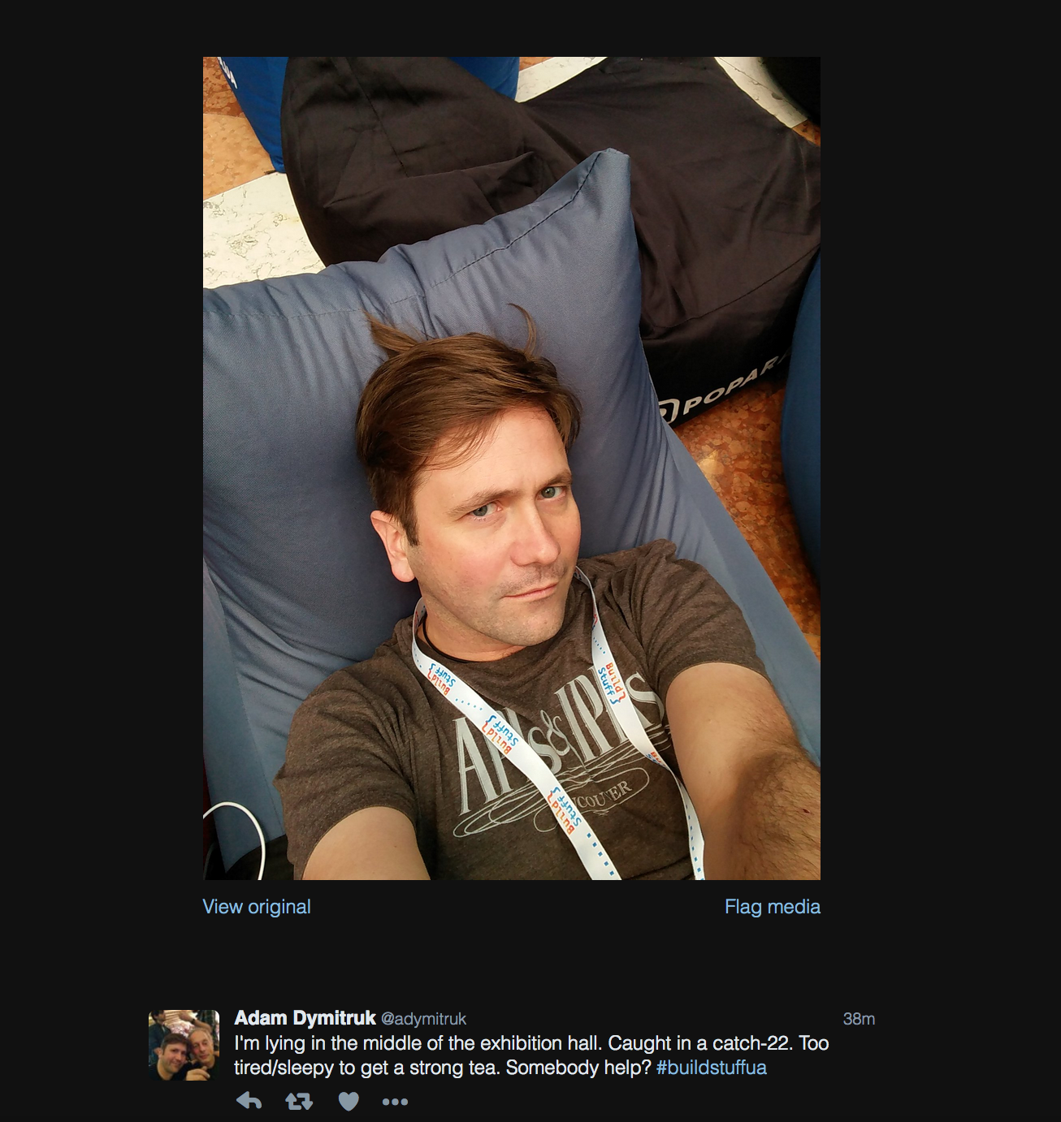

Slide 64
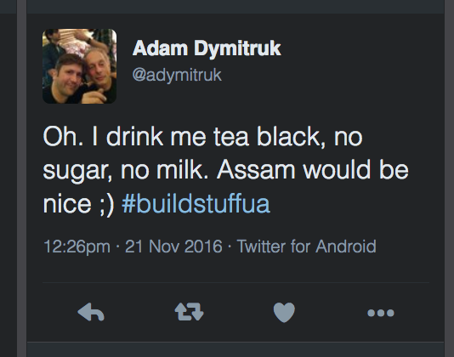

Slide 65
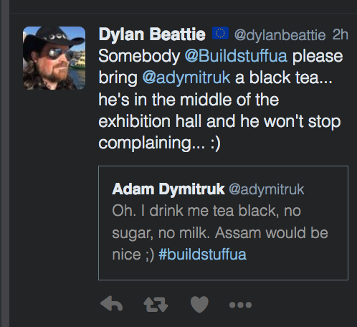

Slide 66
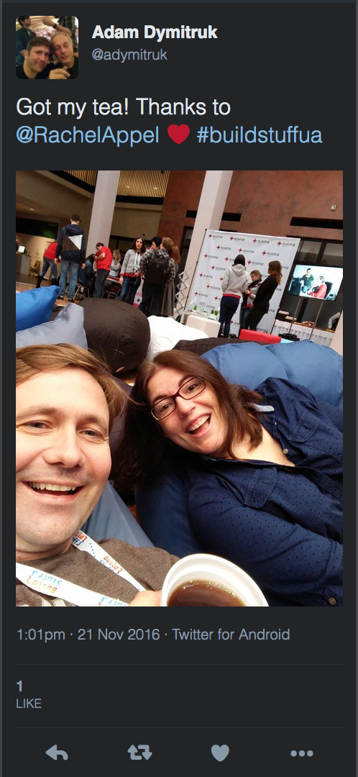

Slide 67
Request-Reply
When an application sends a message, how can it get a response from the receiver?
Send a pair of Request-Reply messages, each on its own channel.
Synchronous Block: Sender blocks whilst polling for reply.
Asynchronous Callback: A separate thread listens for reply messages.
Notes:
Request-Reply: When an application sends a message, how can it get a response from the receiver? Send a pair of Request-Reply messages, each on its own channel.
Synchronous Block: Sender blocks whilst polling for reply. Simple to implement, lower reliability, ties up thread waiting for response
Asynchronous Callback: A separate thread listens for reply messages. Harder to implement for timing issues, more reliable, removes temporal coupling and resource wastage

Slide 68
The request message should contain a Return Address that indicates where to send the reply message
Each reply message should contain a Correlation Identifier, a unique identifier that indicates which request message this reply is for.
Notes:
Message needs Reply Address, must have Correlation Identifier to sender and receiver
Return Address: The request message should contain a Return Address that indicates where to send the reply message. Makes it easier to change than hard-coding response channel into receiver
Correlation Identifier: Each reply message should contain a Correlation Identifier, a unique identifier that indicates which request message this reply is for. This is how a Correlation Identifier works: When the requestor creates a request message, it assigns the request a request ID— an identifier that is different from those for all other currently outstanding requests, that is, requests that do not yet have replies. When the replier processes the request, it saves the request ID and adds that ID to the reply as a correlation ID. When the requestor processes the reply, it uses the correlation ID to know which request the reply is for. This is called a Correlation Identifier because of the way the caller uses the identifier to correlate (i.e., match; show the relationship) each reply to the request that caused it.

Slide 69
Message Sequence
Whenever a large set of data needs to be broken into message-size chunks, send the data as a Message Sequence
Sequence identifier— Distinguishes this cluster of messages from others.
Size or End indicator— Specifies the number of messages
Position identifier— Uniquely identifies and sequentially orders each message in a sequence.
Notes:
Message Sequence: Whenever a large set of data needs to be broken into message-size chunks, send the data as a Message Sequence and mark each
The three Message Sequence identification fields are as follows.
Sequence identifier— Distinguishes this cluster of messages from others.
Position identifier— Uniquely identifies and sequentially orders each message in a sequence.
Size or End indicator— Specifies the number of messages in the cluster or marks the last message in the cluster (whose position identifier then specifies

Slide 70
Useful Properties
Message Expiration: specify a time limit for how long the message is viable.
Format Indicator: An indicator of schema and/or version
Notes:
Message Expiration: Message Expiration to specify a time limit for how long the message is viable.
Format Indicator: How can a message’s data format be designed to allow for possible future changes? Design a data format that includes a Format Indicator so that the message specifies what format it is using.
Version Number— A number or string that uniquely identifies the format. Both the sender and receiver must agree on which format is designated by a particular indicator. The advantage of this approach is that the sender and receiver do not have to agree on a shared repository for format descriptors, but the drawback is that each must know what descriptor is indicated and where to access it.
Foreign Key— A unique ID— such as a filename, a database row key, a home primary key, or an Internet URL— that specifies a format document. The sender and receiver must agree on the mapping of keys to documents and the format of the schema document. The advantage of this approach is that the foreign key is very compact and can point to a detailed data format description in a shared repository. The main drawback lies in the fact that each messaging participant has to retrieve the format document from a potentially remote resource.
Format Document— A schema that describes the data format. The schema document does not have to be retrieved via a foreign key or inferred from a version number; it is embedded in the message. The sender and the receiver must agree on the format of the schema. The advantage of this alternative is that messages are self-contained. However, message traffic increases because each message carries format information that rarely changes.

Slide 71
2.2 channels

Slide 72
Channels
A virtual pipe that connects producer and consumer
Logical Address
Unidirectional
One-to-One or One-to-Many
Messaging is not a ‘bucket’.
Notes:
# Channels #
A producer and a consumer communicate via a channel. A producer sends to a particular channel and a consumer reads from a particular channel
When we talk about messaging patterns, a channel is a logical view of the system not a physical one.
It is the virtual pipe down which messages flow.
Because the pipe is virtual, it's presence is just a logical address to which messages can be sent, and from which they can be received: this may be called a topic or a routing key, depending on the middleware.
Different Message Oriented Middleware solutions may provide different physical implementations of channels, such as whether messages are stored on in memory, on sender and receiver, or in a distributed database.
These details are hidden from producer and consumer who only need to know how to address a channel
A channel is one-way -- we don't want to consume our own messages. For bi-directional messaging we use two channels, one for the request, and one for the reply (the reply channel is usually communicated by the sender)
Messaging is one-to-one (Point-to-point Channel) or one to many (Publish-Subscribe Channel)
A messaging system is not implemented as a bucket. A receiver knows what type of information it wants, and the sender can identify what it is.

Slide 73
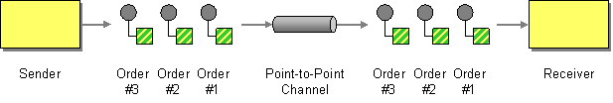
Point-to-Point Channel
http://www.enterpriseintegrationpatterns.com/patterns/messaging/PointToPointChannel.html
Notes:
# Point-to-Point Channel #
With a Point-to-Point Channel only one consumer receives any message. If the channel has multiple consumers, the channel ensures that only one of them succeeds, so the receivers do not have to coordinate with each other.
The channel typically locks a message, either until the locking consumer acks or nacks it, or until the consumer times out on responding and the message is made available again.
If the message is acked, it is deleted from the queue.
Whilst the message is locked, other consumers read past the locked message.
Thus the application can scale out by having multiple consumers receive messages concurrently, but only a single consumer receives any one message.
If the channel chooses to return messages to the channel following a timeout, consumers may have to be prepared to receive duplicate messages, or abandon processing messages, before they time out.

Slide 74
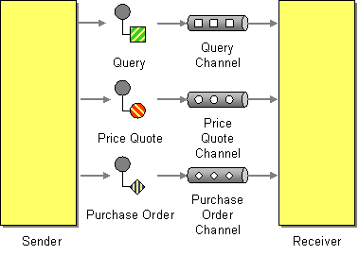
Datatype Channel
http://www.enterpriseintegrationpatterns.com/patterns/messaging/DatatypeChannel.html
Notes:
# Datatype Channel #
When a producer sends a message, how does the consumer know how to process it?
How does it know what the schema of the message body is, in order to deserialize the content and act upon it?
We can use a separate channel for each separate message schema, so that all messages on a particular channel share the same schema.
The producer, knowing what type the message is, publishes to an appropriate channel serializing the data to the message body.
The consumer, knowing what channel the message was received on, will know what its type is, and can deserialize the message body.
If a Datatype channel is not used, then the consumer will need to inspect the message to determine the type, using metadata in the message header or body, and then lookup how de-serialize messages of that type, before routing them to code that knows how to handle them.
This is unneeded complexity if a separate channel can be used.
The reason not to use a datatype channel is where there are messages that need to be processed in sequence but the messages have different schemas and they cannot be unified under a single schema.

Slide 75
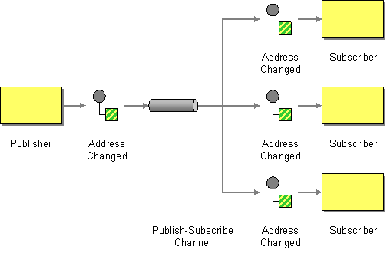
Publish-Subscribe Channel
http://www.enterpriseintegrationpatterns.com/patterns/messaging/PublishSubscribeChannel.html
Notes:
# Publish-Subscribe Channel #
If in a point-to-point channel only one consumer receives a message, how do I broadcast a message so that many consumers receive the same message?
Publish the message on a Publish-Subscribe Channel, which delivers a copy of a particular message to each consumer.
A Publish-Subscribe Channel has a publisher who sends a message to one input channel which is then replicated onto many output channels, each belonging to a separate subscriber.
When an event is published into the channel, the Publish-Subscribe Channel delivers a copy of the message to each of the output channels.
Each output channel functions much as a point-to-point channel. On any output channel, a consumer is only allowed to receive a message once. The middleware must use locking and read past to ensure that with multiple listeners, only one listener consumes the message.
Publish-subscribe allows eavesdropping on a message; a firehose of all channels can act like a message store.
A message may be sent by one publisher and consumed separately by many consumers via a router, which we discuss later. Both the channel and router based approach are often short-handed as publish-subscribe.

Slide 76
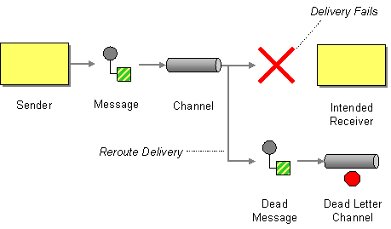
Dead Letter Channel
http://www.enterpriseintegrationpatterns.com/patterns/messaging/DeadLetterChannel.html
Notes:
# Dead Letter Channel #
What does the middleware do with a message a publisher sends, that it cannot deliver to the intended channel?
It may choose to move the message onto a Dead Letter Channel, which can later be reviewed by the operator. Often, the middleware will attempt redelivery of the message to channel a number of times, before it moves it to a dead letter channel.
Implementations vary. For example, a dead letter channel might be a point-to-point channel that can be read by one consumer, or a publish-subscribe channel that can be read by many consumers.
There is confusion between a dead letter channel, and an invalid message channel (the next pattern we will look at). We will discuss that issue further when considering that pattern.

Slide 77
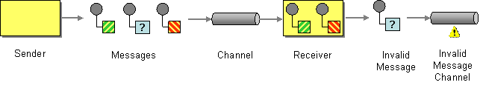
Invalid Message Channel
http://www.enterpriseintegrationpatterns.com/patterns/messaging/InvalidMessageChannel.html
Notes:
# Invalid Message Channel #
What happens when the message a consumer receives cannot be understood? For example the message is missing headers, or the body has an unexpected content type or does not match the expected schema.
Although the middleware has delivered the message to the receiver it cannot be passed to application code to process.
Further attempts to process the message will continue to result in failure because it is badly formed. The message risks becoming a 'poison pill' as the consumer will continue to try to read it from the channel. If there is a single consumer it will be blocked from reading other messages. If there is more than one consumer, a consumer will continue to 'choke' on that message.
But simply removing the message from the channel, by acking it but discarding it, risks that we will lose data. For example, it might be that a badly configured producer or consumer was using the wrong channel and the message was good.
The consumer should move the message to an Invalid Message Channel, a special channel for messages that could not be processed by their receivers.
Messages that cause application errors, but are well formed, should not be placed on the Invalid Message Channel, but treated as application errors.
The Dead Letter Channel is for messages that cannot be delivered to the channel, and the Invalid Message Channel is for messages that were delivered, but cannot be understood.
Some middleware, for example RabbitMQ confuses these terms, and uses Dead Letter Channel as an Invalid Message Channel, the destination for messages that the consumer rejects.

Slide 78
2.3 endpoints

Slide 79
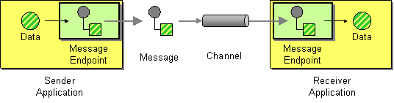
Message Endpoint
http://www.enterpriseintegrationpatterns.com/patterns/messaging/MessageEndpoint.html
Notes:
Applications are communicating by sending Messages to each other via Message Channels.
How does an application connect to a messaging channel to send and receive messages?
Connect an application to a messaging channel using a Message Endpoint, a client of the messaging system that the application can then use to send or receive messages.
Message Endpoint code is custom to both the application and the messaging system’s client API. The rest of the application knows little about message formats, messaging channels, or any of the other details of communicating with other applications via messaging. It just knows that it has a request or piece of data to send to another application, or is expecting those from another application. It is the messaging endpoint code that takes that command or data, makes it into a message, and sends it on a particular messaging channel. It is the endpoint that receives a message, extracts the contents, and gives them to the application in a meaningful way.

Slide 80
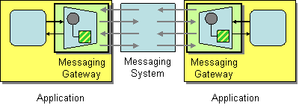
Messaging Gateway
http://www.enterpriseintegrationpatterns.com/patterns/messaging/MessagingGateway.html
Notes:
An application accesses another system via Messaging.
How do you encapsulate access to the messaging system from the rest of the application?
Use a Messaging Gateway, a class than wraps messaging-specific method calls and exposes domain-specific methods to the application.
The Messaging Gateway encapsulates messaging-specific code (e.g., the code required to send or receive a message) and separates it from the rest of the application code. This way, only the Messaging Gateway code knows about the messaging system; the rest of the application code does not. The Messaging Gateway exposes a business function to the rest of the application so that instead of requiring the application to set properties like Message.MessageReadPropertyFilter.AppSpecific, a Messaging Gateway exposes methods such as GetCreditScore that accept strongly typed parameters just like any other method. A Messaging Gateway is a messaging-specific version of the more general Gateway pattern [EAA].

Slide 81
2.3.1 The Message PuMP

Slide 82
Dead Letter Channel
Error Log
Error Log
Invalid Message Channel
Failure to understand
Unexpected
Unrecoverable
Exception
Failure to deliver
Get Message
Translate Message
Dispatch Message
Handle Message
Requeue to Limit
Recoverable
Exception
Notes:
# The Message Pump #
The Message Pump is the name given to the code that takes a message from a channel, and delivers it to application code. The pump runs in a loop, until cancelled.
The loop takes messages from the channel, and then translates the data in the message body into a type that can be understood by the application code.
The pump then looks up application code registered to handle messages of that type, and sends the translated message to that application code to be handled.
Control passes from the Message Endpoint to application code, which executes in response to receipt of the message and handles it.
When errors occur in the middleware, whilst attempting to deliver the message to the endpoint, the message can be moved to a Dead-Letter Channel.
When errors occur translating a message, then the message can be moved to an Invalid Message Channel.
If errors occur dispatching a message to application code, it should be logged, and an exception thrown, as the application has been incorrectly configured. The message should not be acked and the application should be shut down, to avoid losing data.
If errors occur in the application code, and those errors are not recoverable, then the message should be acked to remove it from the channel, as replaying it would have the same consequences, and the error should be logged. Processing may be able to continue with subsequent messages.
If the message could be retried, because the condition causing the error is transient, then the message can be put back onto channel (usually with a delay) to retry. An upper limit on the number of retries is usually placed, to avoid poison pill messages. Ideally, messages that exceed the retry limit, should be handled the same way as an unrecoverable exception

Slide 83
Translate and Dispatch
Message Mapper Registry
Handler Registry
Lookup Mapper
Lookup Handler
Get Message
Translate Message
Dispatch Message
Handle Message
Notes:
A Messaging Mapper converts domain objects into a message as required by the messaging channel.
It also provides the reverse capability, create or update a domain objects based on an incoming messages.
Because of this mediator, the domain does not need to know about messaging formats and vice-versa
Typically, the endpoint allows registration of message mappers for channels, and uses a data type channel.
The application code that executes in response to a message it typically called a handler. Typically, handlers are subscribed to channels that the endpoint is configured to listen on.

Slide 84
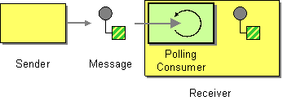
Polling Consumer
http://www.enterpriseintegrationpatterns.com/patterns/messaging/PollingConsumer.html
Notes:
In a Polling Consumer, the message pump makes an explicit call to check for the availability of messages to consume. This consumes a thread in the application, even if no messages are ready, but does not require a connection to be held open to the middleware.

Slide 85

Event Driven Consumer
http://www.enterpriseintegrationpatterns.com/patterns/messaging/EventDrivenConsumer.html
Notes:
In an Event Driven consumer, the message pump registers a callback with the middleware, and it is called when a message is available to be read, and passed the message. This does not consume a thread in the application, but it does require the connection between the client and the middleware server to be held open or for the application to serve requests from the middleware.

Slide 86
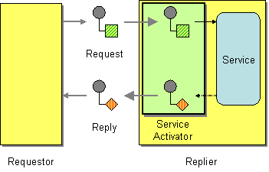
Service Activator
http://www.enterpriseintegrationpatterns.com/patterns/messaging/MessagingAdapter.html
Notes:
# The Service Activator #
Whilst the message pump outlined directs calls to application code in response to messages, it is valuable for that code to be invoked by other callers. This is particularly useful to support writing developer tests against the handler, but can also allow the same code to service requests received via different protocols for example HTTP or GRPC.
A Service Activator is the pattern by which the endpoint code invokes application code to handle the message, but that application code is independent of the messaging endpoint. This can be synchronous and non-remote a method call - usually exposed by a service layer. The activator can be hard-coded to always invoke the same service, or can use reflection to invoke the service indicated by the message. The activator handles all of the messaging details and invokes the service like any other client, such that the service doesn’t know it’s being invoked through messaging.
A Service Activator can be one-way (request only) or two-way (Request-Reply).

Slide 87
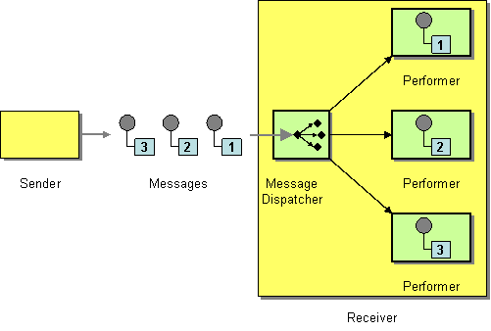
Competing Consumers
http://www.enterpriseintegrationpatterns.com/patterns/messaging/MessageDispatcher.html
Notes:
# Competing Consumers #
If we wish to avoid a channel backing up, we must consume messages from the channel faster than they arrive. A simple algorithm helps with this. We compare the rate of arrival of messages with the rate of consumption of messages - how long before we ack or nack that message. If the rate of arrival exceeds the rate of consumption, we will back up. If this is not a burst of messages, and if we do not have a rate of consumption greater than that of arrival, we will not be able to eat our way through any backlog; we will now never catch up.
We may also need to process the message within a certain period from when they are published. If those messages come in bursts, but the processing of individual messages in the burst takes too long, we might not be able to process within that period.
The solution to both of these issues is to increase the number of consumers reading messages from the channel. The message queue must hand a message to only one consumer, so it must lock the message on the channel whilst it is being processed, and unlock it if it is returned to the channel. For example if the consumer fails. It must allow waiting consumers to read messages further down the channel if the message at the front is locked.
Competing consumers can create a problem with messages that need to be processed in sequence. Due to the requirement to lock and read past, consumers will not be able to guarantee that they will process messages on a channel in sequence. Indeed they may undo any sequence that the channel has already. In this case you cannot use competing consumers.
Instead, if the rate of arrival exceeds the rate of consumption you must partition the messages using a consistent hashing algorithm such that you can preserve order within a partition and ensure that the rate of arrival of messages on a partition does not exceed the rate of consumption of messages from a single consumer of that partition.

Slide 88
2.4 Pipelines

Slide 89

Pipes and Filters
http://www.enterpriseintegrationpatterns.com/patterns/messaging/PipesAndFilters.html
Notes:
# Pipes and Filters #
When we publish a message, we may need to do work before the eventual subscriber of that message takes action against our domain. We might need to encrypt/decrypt a message, we might need to enrich the content of the message from other data stores, or we might need to transform the message from one format to another.
Pipes and filters is a pattern for dividing the transformation of data between origin and destination into steps that can be combined together. A data source at the head of the pipe begins the flow, and a data sink at the tail of the pipe receives the transformed output. Filters transform the data as it flows through the pipe.
We can treat the publisher as the data source, the final consumer as the data sink. and consumers that read, transformed, and publish that message before it reaches the sink as filters.
The structure of pipes and filters is straightforward. Each filter receives a message on an inbound channel and publishes it on an outbound channel. The pipe connects one filter to the next, sending output messages from one filter to the next. Because each filter uses the same approach they can be composed into a chain. This allows simple, easily testable filters to be composed into arbitrarily complex applications.
A processing pipeline lets us work in parallel, because a filter can take more work off the queue to process when done, instead of blocking whilst the rest of the pipeline completes. This is known as a processing pipeline because messages flow through the filters like liquid through a pipe. A processing pipeline helps to increase throughput. A processing pipeline's throughput is limited by the slowest point in the chain. We could use multi-threading within that filter, but the alternative is to use competing consumers to parallelize the work of a stage. This allows one of many consumers to complete the work of that stage and is simpler to program and debug than using multi-threading.

Slide 90
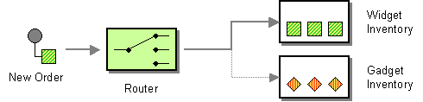
Content Based Router
http://www.enterpriseintegrationpatterns.com/patterns/messaging/ContentBasedRouter.html
Notes:
# Content Based Router #
We may need a pipeline to branch. The condition that determines which path to take, may be based on the content of the message.
A Content-Based Router examines the message content and routes the message onto a different channel based on data contained in the message. The routing can be based on a number of criteria, such as existence of fields, specific field values, and so on.
The routing function should be easy to maintain, as the router can become a point of frequent maintenance. Some middleware provide configurable rules-engines to support complex routing decisions or topologies. Be wary of moving too much decision making into middleware as this can become difficult to maintain or test.

Slide 91
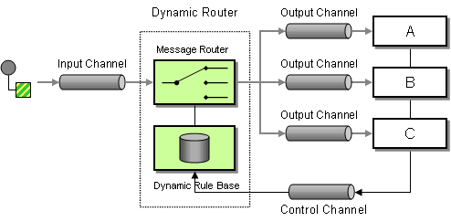
Dynamic Router
http://www.enterpriseintegrationpatterns.com/patterns/messaging/DynamicRouter.html
Notes:
# Dynamic Router #
A content-based router can be difficult to maintain, because the router has to know about the possible branches in the path, thus creating a need to re-configure that router if the topology of the system changes.
A dynamic routers solves this problem by using a rules-engine to send messages to destinations which can be configured at run time.
A control channel allows configuration of the routing to be set by consumers. As a consumer starts up, it registers with the router to indicate the rules under which it should be sent messages. The Dynamic Router runs the rules over a message on receipt and determines the destination.
Because consumers supply the rules under which the message should be routed to them, the dynamic router must determine what happens if two rules conflict, indicating that a message should be forwarded to more than one channel. Common strategies include last one wins. It is possible to route to all valid routes, but this is often actually another pattern: the recipient list.

Slide 92
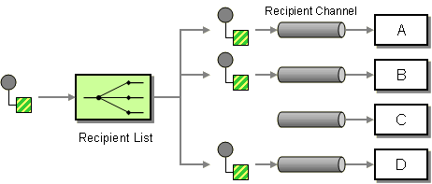
Recipient List
http://www.enterpriseintegrationpatterns.com/patterns/messaging/RecipientList.html
Notes:
# Recipient List #
In a content-based router, the properties of the message determine which branch a message takes. We may want the publisher to be able to explicitly decide which branches to take, by means of a recipient list of which paths should receive the message.
A metaphor here is the To list of an email - we indicate the recipients of the email and it is routed to them.
We define a channel for each recipient. The Recipient List inspects an incoming message, determine the list of desired recipients, and forwards the message to all channels associated with recipients in the list.
It is possible to invert the recipient list to give control to the consumers. In a dynamic recipient list, consumers send a list of messages they wish to subscribe to, via a control channel, to the Recipient List. This allows them to filter the messages that they wish to receive.
A dynamic Recipient List can be used to implement a Publish-Subscribe Channel if a messaging system provides only Point-to-Point Channels but no Publish-Subscribe Channels. The Recipient List would keep a list of all Point-to-Point Channels that are subscribed to a topic. The publisher indicates the topic when sending the message, and the Recipient List routes the message to channels subscribed to that topic. This can be used to provide control, such as authorization, of subscriptions to a topic
Exchanges in RabbitMQ and SNS subscriptions in AWS are examples of dynamic recipient lists.

Slide 93
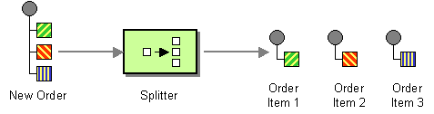
Splitter
http://www.enterpriseintegrationpatterns.com/patterns/messaging/Sequencer.html
Notes:
# Splitter #
It may be that filters in the pipeline correspond to parts of a message, and it may be more efficient to split a message into multiple messages, derived from those dependencies, and send those new messages to those filters.
A splitter takes one input message, and breaks it into multiple output messages.
For example, different line items in an order, may need be handled by different consumers, and a splitter can route each line item in the order to the correct consumer.
It may also be useful where there is a batch of work in the original message. It can be difficult to observe the progress of a batch, it is either all waiting to be done, or done. Splitting the batch up allows us to observe the progress on the parts of the batch more easily, by the simple expedient of monitoring the number of messages waiting to be processed in the channel.

Slide 94
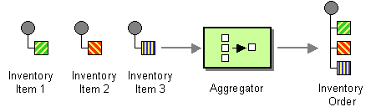
Aggregator
http://www.enterpriseintegrationpatterns.com/patterns/messaging/Aggregator.html
Notes:
# Aggregator #
A Splitter lets us break out a single message into parts, multiple messages that can be processed individually. It may be necessary to recombine these parts for further processing.
For example, when we use a Splitter to break up a batch job, we want to know when the batch completes, because all of the parts of the batch have completed. We also want to know if some parts of a batch completed, but others did not.
An Aggregator collects and stores individual messages until a complete set of related messages has been received. Then, the Aggregator publishes a single message distilled from the individual messages.
An Aggregator depends on being able to correlate messages, usually by adding a correlation id to the message headers, to easily allow messages to be recombined. With a batch, it can also be useful for the aggregator to know how many messages were i the batch, so that the aggregator knows when it has seen all the messages.

Slide 95
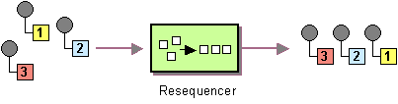
Resequencer
http://www.enterpriseintegrationpatterns.com/patterns/messaging/Resequencer.html
Notes:
# Resequencer #
If the pipeline has conditional or parallel filter steps, some messages may complete the pipeline before others. If the messages were published in order, that order may now be lost.
In the presence of errors, a filter step might be retried, which may move the retried message out of order.
If we have competing consumers reading from a channel, they will de-order the messages arriving on that channel.
If we need to re-order messages we can use a Resequencer. A Resequencer uses an internal buffer to store out-of-sequence messages until a complete sequence is obtained. The in-sequence messages are then published to the output channel.
The Resequencer needs to store the sequence number of the next expected message. A Resequencer first looks in its own buffer, to see if it has already read that message from the channel. If not, it reads another message from the channel. If that is the expected message it processes it, otherwise it puts it into the buffer. The process then repeats. Eventually, a message waiting in the buffer will be the next message, and will be freed.

Slide 96
2.5 Transformation

Slide 97
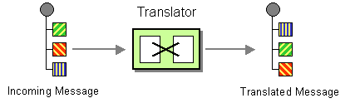
Message Translator
http://www.enterpriseintegrationpatterns.com/patterns/messaging/MessageTranslator.html
Notes:
# Message Translator #
The publisher may not use a format for a message that is understood by all consumers. This may be a version issue -- a downstream consumer may not be ready to receive a message whose format has a breaking change. It may be an issue with schemas that are not under control of the engineering team, such as external system or legacy code.
A message translator is a filter step that converts a message from one schema to another, so that the output can be received by consumers that accept the alternative format.
In many cases a translator is temporary, once the consumer can accept the schema of the publisher then the translator can be retired.

Slide 98
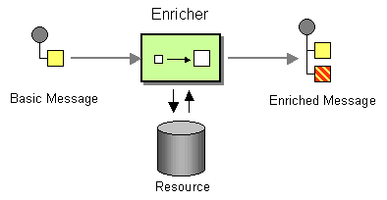
Content Enricher
http://www.enterpriseintegrationpatterns.com/patterns/messaging/DataEnricher.html
Notes:
# Content Enricher #
The data source in a pipeline, the publisher, may not have all the data that the data sink, the consumer, needs to process the message.
Imagine that the publisher sends a new order with an account id, but to ship the order we need the customer's address details, which are held on their account. The shipping consumer needs the customer's address to be added to the order message, before it can process the message.
This scenario is particularly common in microservice architectures, where each microservice only holds data that pertains to its area of responsibility and not others, requiring the data in the publisher's message to be joined to data held by other miroservices.
A Content Enricher is a filter step that adds the required data to the message.
In the above example, one system publishes the order, a filter step belonging to another system listens to that message and enriches the content with the address data, and the system that handles shipping now has the data that it needs to process the order.

Slide 99
2.6 Management

Slide 100
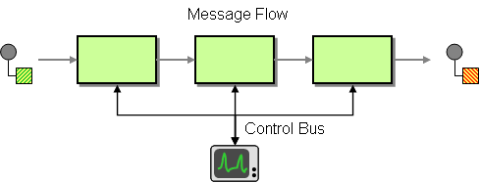
Control Bus
http://www.enterpriseintegrationpatterns.com/patterns/messaging/ControlBus.html
Notes:
How can we effectively administer a messaging system that is distributed across multiple platforms and a wide geographic area?
Use a Control Bus to manage an enterprise integration system. The Control Bus uses the same messaging mechanism used by the application data, but uses separate channels to transmit data that is relevant to the management of components involved in the message flow.
Each component in the system is now connected to two messaging subsystems:

Slide 101

Further Reading

Slide 102
Q&A

